Slide 1
Code output
Baguma Gerald 2023-B072-31712

Slide 2
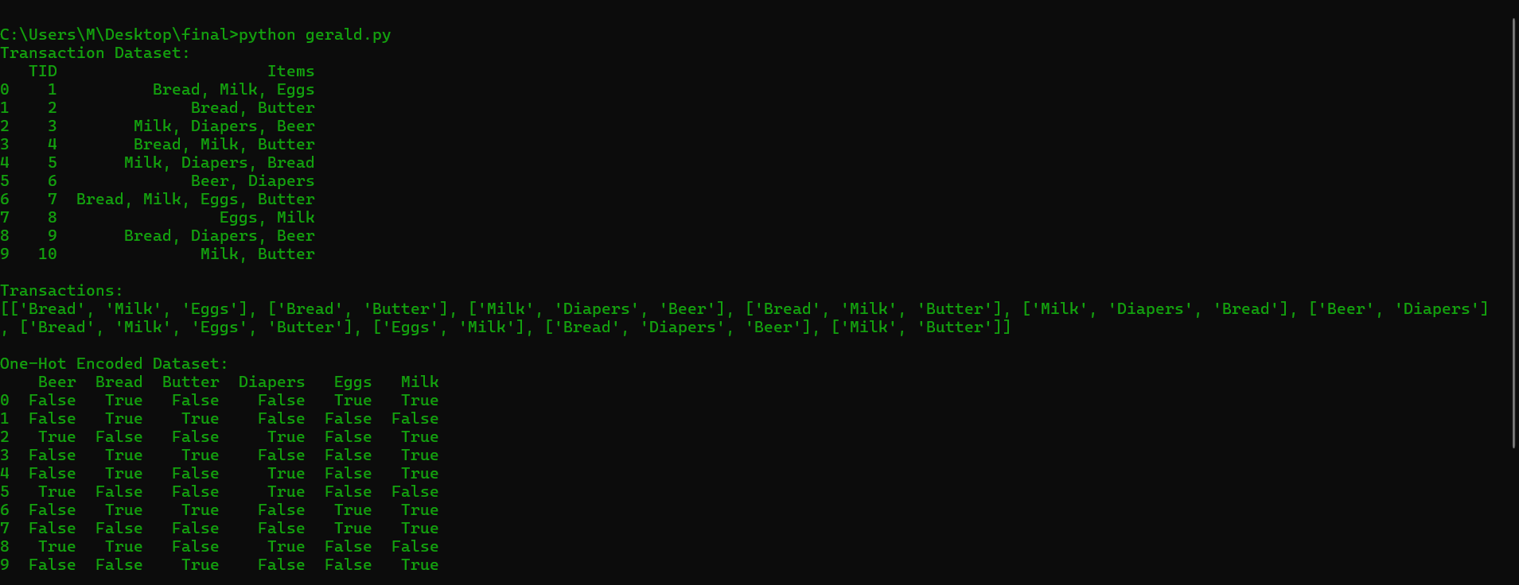
PART A: DATASET, TRANSACTION AND ONE ENCODED FORMAT

Slide 3
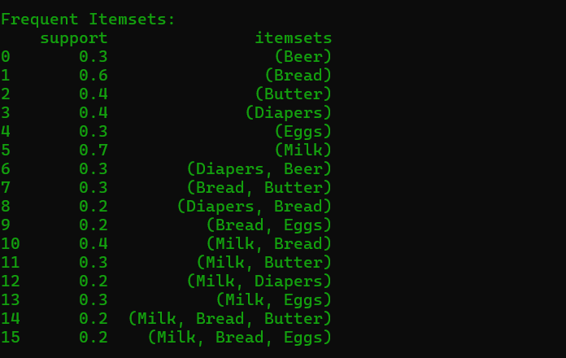
PART B : APRORI ALGORITHM_FREQUENT ITEMSETS

Slide 4
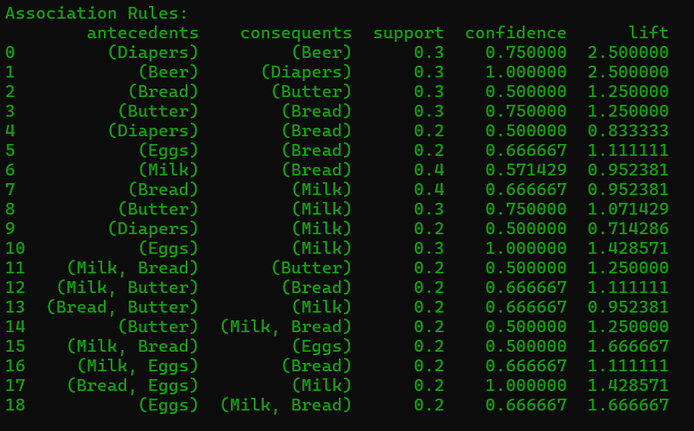
PART B : APRORI ALGORITHM_ASSOCIATION RULES

Slide 5
PART C THREE STRONGGEST RULES BASED ON LIFT
Rule 1: Diapers → Beer
This rule indicates that customers who buy diapers are also very likely to buy beer in the same transaction.
Interpretation:
There is a strong association between diapers and beer purchases, suggesting complementary buying behavior, possibly driven by household or lifestyle patterns.
Rule 2: Bread & Milk → Butter
Customers who purchase bread and milk together have a high probability of also buying butter.
Interpretation:
These items are commonly used together, indicating a typical breakfast or household shopping pattern.
Rule 3: Eggs → Milk
The rule shows that when customers buy eggs, they are likely to also buy milk.
Interpretation:
This suggests that eggs and milk are complementary products frequently purchased together for home consumption.

Slide 6
BUSINESSS RECOMENDATIONS
1. Product placement strategy
Place diapers and beer close to each other in the supermarket or promote them together.
This can increase impulse purchases and overall basket value.
2. Cross-Selling & Promotions
Bundle bread, milk, and butter or offer discounts when customers buy these items together.
This encourages customers to purchase related items in one trip, improving sales and customer convenience.

